Slide 1
TreadMarks:
Distributed Shared Memory on Standard Workstations and Operating Systems
Present By: Blair Fort
Oct. 28, 2004

Slide 2
Overview
Introduction and Motivation
Implementation
Experiments and Results
Conclusions
My two cents

Slide 3
Introduction
Threadmarks is a Distributed Shared Memory system
Unix workstations over an ATM or Ethernet network

Slide 4
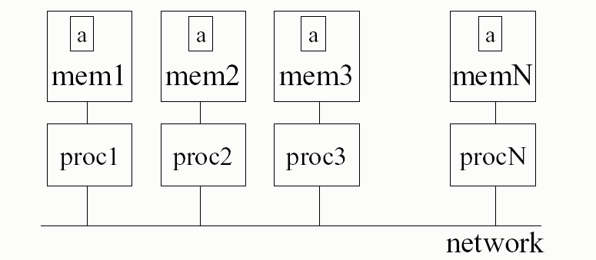
Cluster Configuration

Slide 5
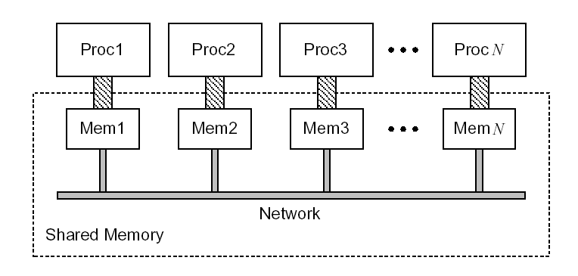
Distributed Shared Memory

Slide 6
Motivation
No widely available DSM system
Eliminate problems of other system
  Bad portability
  Bad performance
  False sharing

Slide 7
Goals
Ease of Use
Portability
Good Performance
  Also show that it works for real programs

Slide 8
Overview
Introduction and Motivation
Implementation
Experiments and Results
Conclusions
My two cents

Slide 9
Ease of Use
Looks a lot like pthreads
Implicit message passing
Implicit process creation

Slide 10
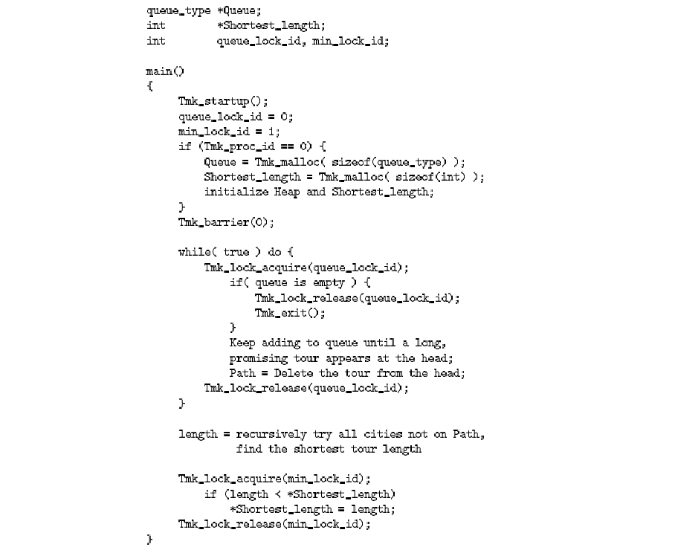

Slide 11
Portability
Only standard Unix System Calls
  Message Passing
  Memory Management

Slide 12
Performance
False sharing
Excessive message passing

Slide 13
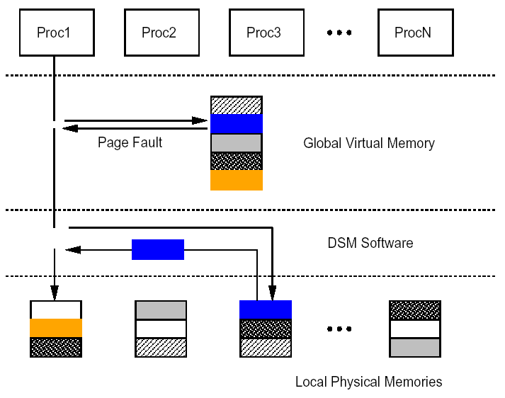
Conventional DSM Implementation

Slide 14
Sequential vs Release Consistency
Every Write is broadcasted
More Message Passing
Writes are broadcasted only synchronization points
More Memory overhead

Slide 15
Read-Write False Sharing
w(x)
w(x)
w(x)
r(y)
r(y)
r(x)

Slide 16
Read-Write False Sharing
w(x)
w(x)
r(y)
r(y)
r(x)
synch

Slide 17
Write-Write False Sharing
w(x)
w(x)
w(x)
w(y)
w(y)
r(x)
synch

Slide 18
Multiple-Writer False Sharing
w(x)
w(x)
w(x)
w(y)
w(y)
r(x)
synch

Slide 19
Eager vs. Lazy RC
Sends Messages at release of lock or at barriers
Broadcasts Messages to all nodes
Sends Messages when locks are acquired
Message goes only to the required node

Slide 20
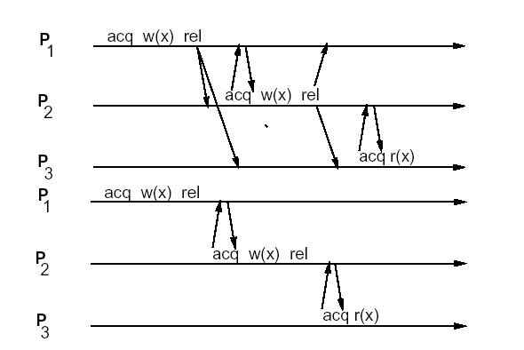
Eager vs. Lazy RC

Slide 21
Memory Consistency
Done by creating diffs
Eager RC creates diffs at barriers
Lazy RC creates diffs at the first use of a page

Slide 22
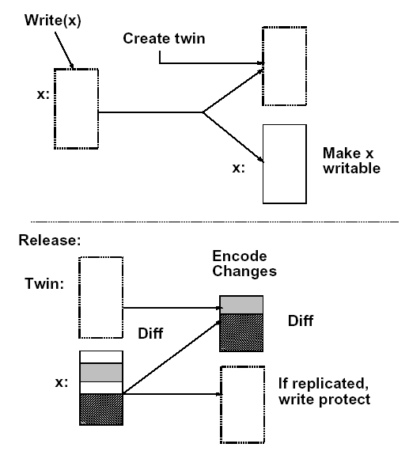
Twin Creation

Slide 23
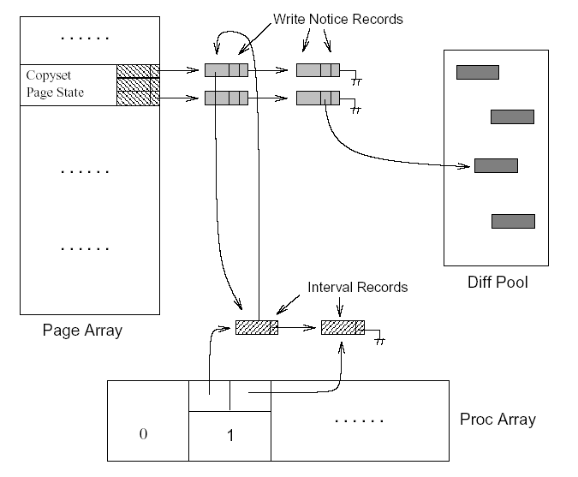
Diff Organization

Slide 24
Vector Timestamps
1
0
0
0
0
0
w(x) rel
p1
1
1
0
acq w(y) rel
0
0
0
p2
acq r(x) r(y)
p3
0
0
0

Slide 25
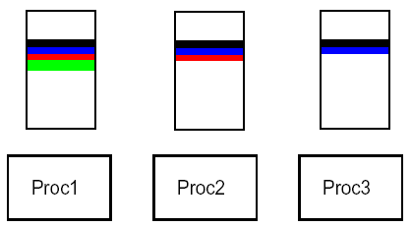
Diff chain in Proc 4

Slide 26
Garbage Collection
Used to merge all diffs – recover memory
Occurs only at barriers
All nodes that have a pages must have all diffs of that page.

Slide 27
Overview
Introduction and Motivation
Implementation
Experiments and Results
Conclusions
My two cents

Slide 28
Testing Platform
8 DECstation-5000/240’s running Ultrix V4.3
Network:
  ATM 100Mbps
  Ethernet 10Mbps

Slide 29
Testing Programs
Modified Water from Splash
Jacobi
TSP
QuickSort
ILINK

Slide 30
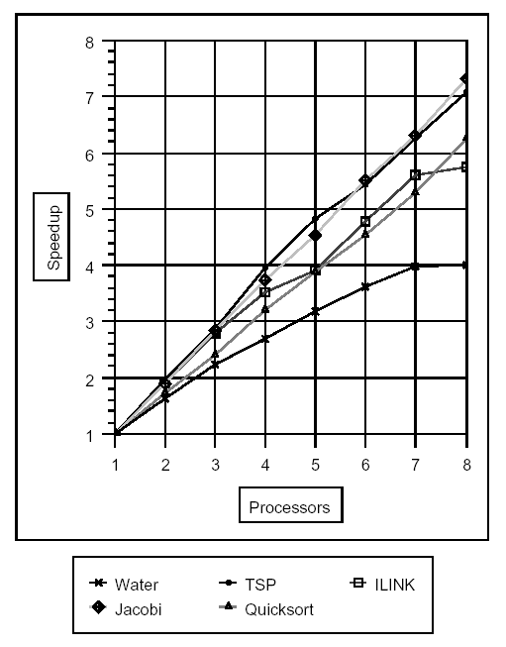

Slide 31
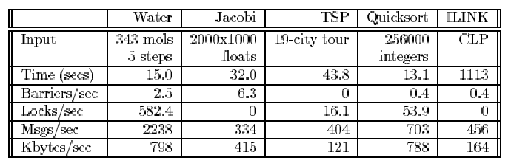

Slide 32
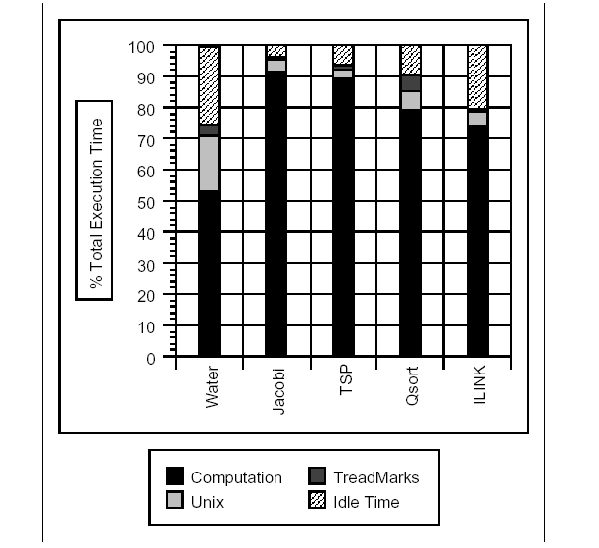

Slide 33
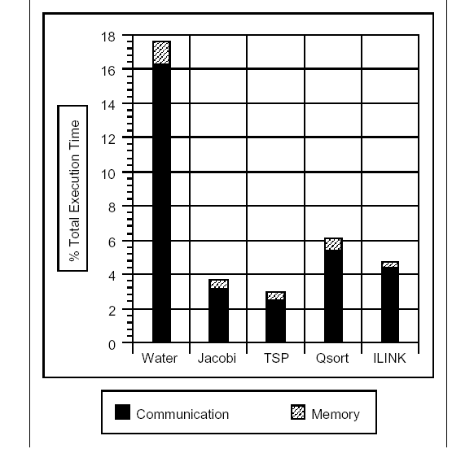
Unix Overhead

Slide 34
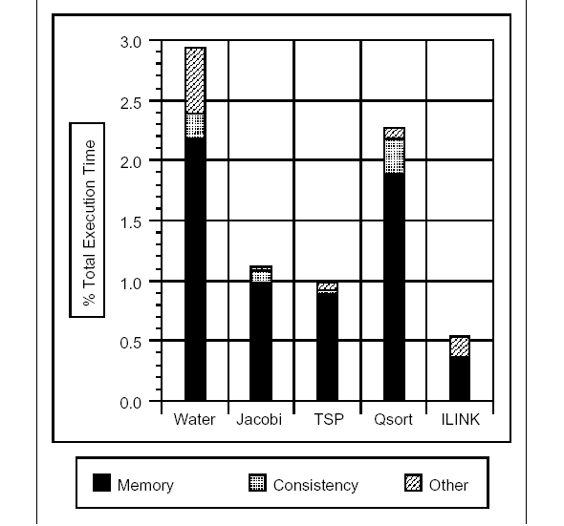
ThreadMarks Overhead

Slide 35
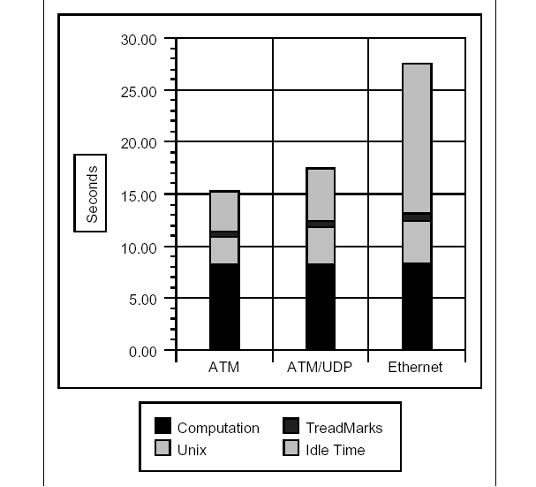
Network Comparison - Water

Slide 36
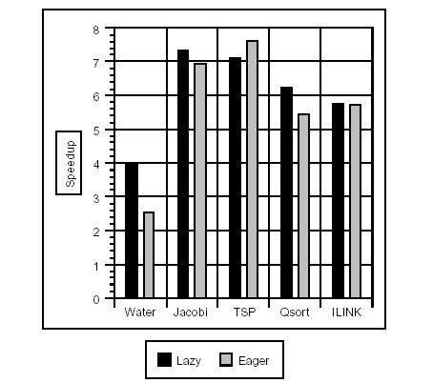
Lazy vs Eager RC

Slide 37
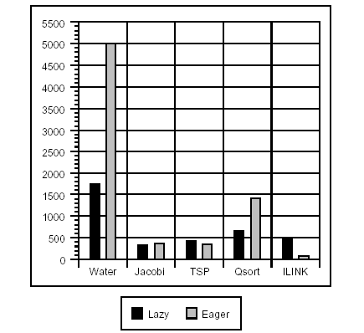
Message Rate

Slide 38
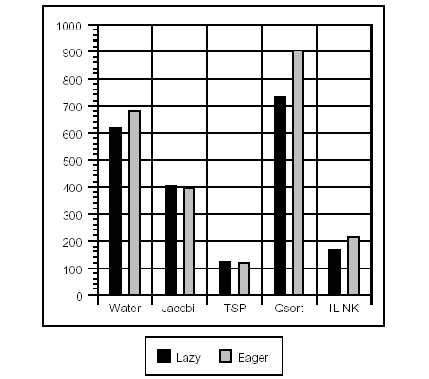
Data Rate

Slide 39
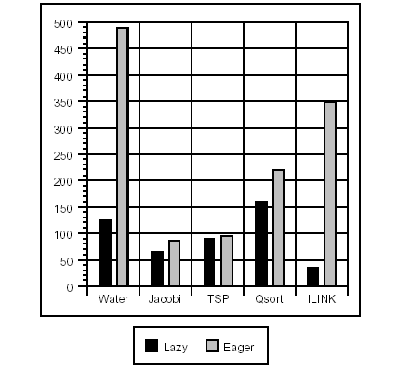
Diff Creation Rate

Slide 40
Overview
Introduction and Motivation
Implementation
Experiments and Results
Conclusions
My two cents

Slide 41
Conclusions
Automated Distributed Shared Memory system works for real programs!
LRC improves performance over ERC for most cases

Slide 42
Overview
Introduction and Motivation
Implementation
Experiments and Results
Conclusions
My two cents

Slide 43
My Thoughts
Good design – promotes re-use
Would like to see a comparison over hand-coding the message passing
Why not a partial merging of diffs?

Slide 44
Comments/Questions

